Slide 1
RFID – Attendance System

Slide 2
Introduction
Managing and supervising the attendance of every student is a tough job and lot of time wasting, So this can be simply done by a using NodeMCU, RFID Scanner and simply installing a software on pc for this We have designed a small attendance managing system which can be used at different offices, colleges etc. Which will be able to add new cards corresponding to the different members and see their arrived and left timings by simply scanning those cards. We have also tried to add database to store all the logs. We can also check the members that arrived late or leave earlier

Slide 3
Description
First we have to store all the cards with the respective information of Student/Employee.
Once the card is stored this cards are ready to generate logs by simply taking the cards towards the rfid scanner
If the student is arrived late or leaving earlier Red light is turned on otherwise if they are on time Blue light is turned on
This logs are stored on Database and can be accessed by login to database, they can also be exported in excel, csv and other forms.

Slide 4
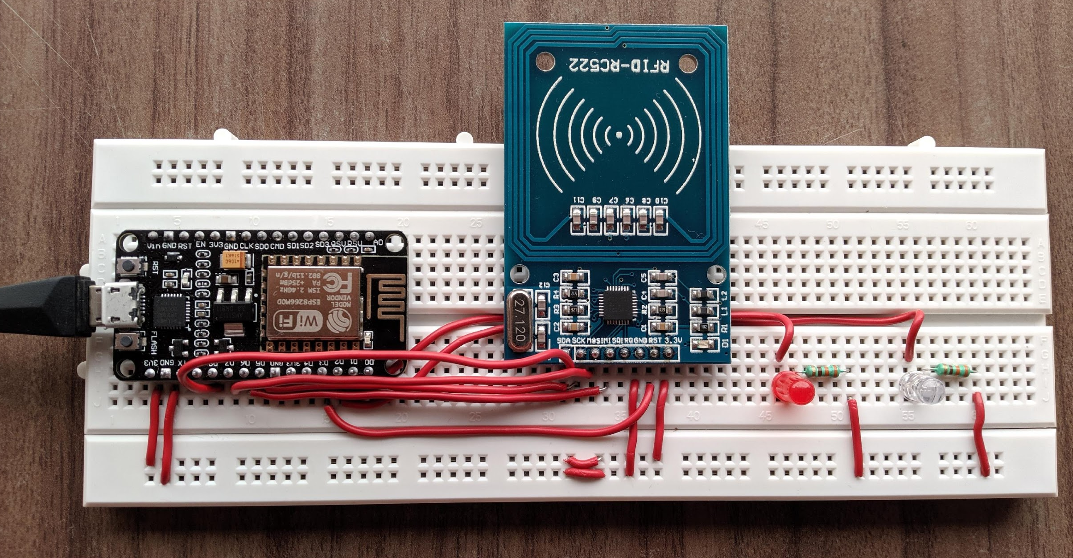
Getting Circuit ready
Components :
NodeMCU
RFID-Scanner
Red LED
Blue LED
330 ohm resistor(2 qty)

Slide 5
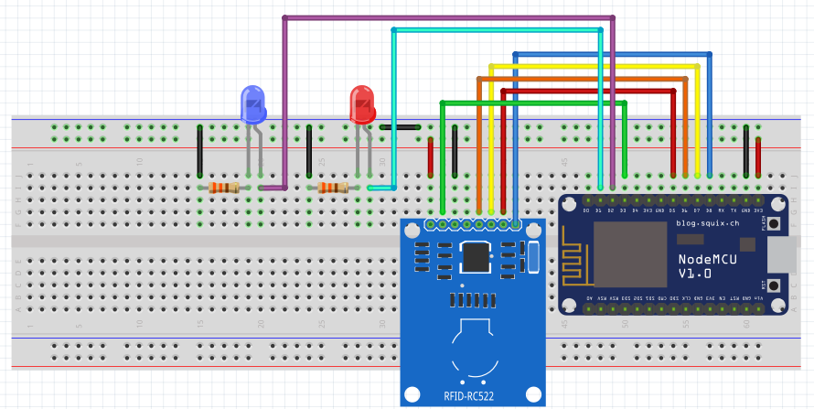
Pin Diagram
Connections
NodeMCU | RFID-Scanner
3v3 | 3v3
GND | Cathode LED
D8 | SDA
D7 | MOSI
D6 | MISQ
D5 | SCK
D3 | RST
D2 | Red annode
D1 | Blue annode

Slide 6
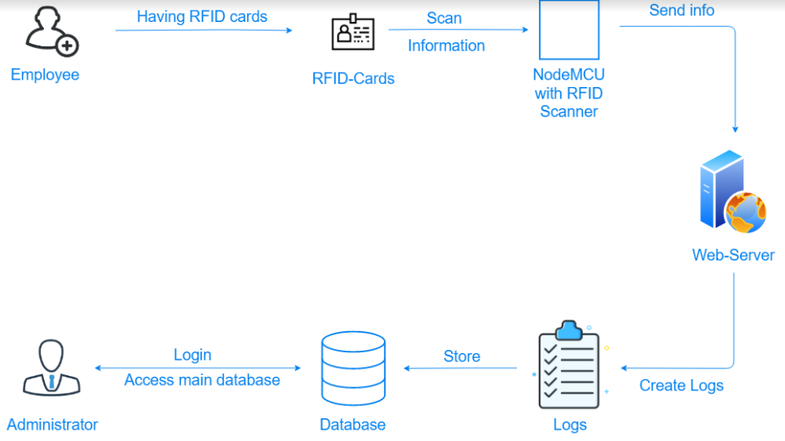
Technology Stack
Arduino C programming
Html
CSS
PHP
MySQL
Dependencies
NodeMCU
Internet
RFID scanner
Computer

Slide 7
Thank You
TEAM INDENT
Dharmesh Poladiya
Ashish Shethia
Harsh Valia

